Slide 1

Risks and Data Analytics
Marek Krawczyk
DAT-610
Notes:
Thank you for having me here today, I appreciate your time and attention today. Our main goal for today is to try to identify risk categories and present the value of data analytics in Risk Management. This presentation will follow the guidelines laid out by the BASEL II and BASEL III framework.

Slide 2
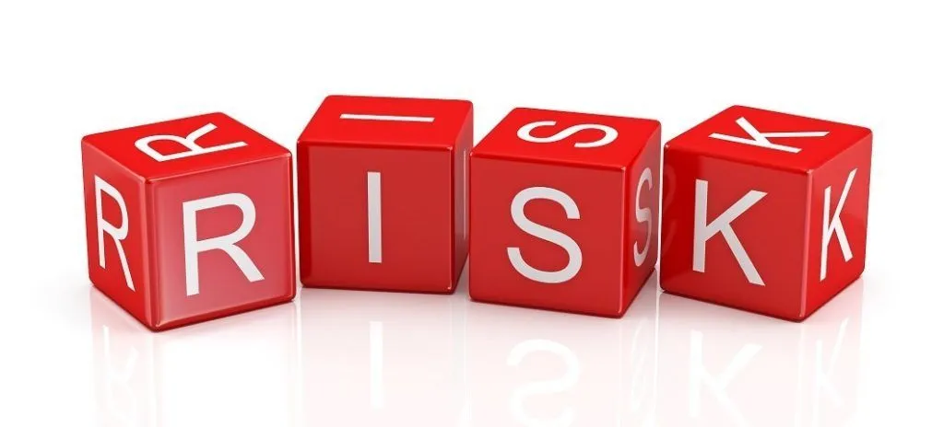
What is RISK?
BASEL II/III –
“The risk of loss resulting from inadequate or failed internal processes, people and systems or from external events”
Notes:
What is RISK? Although most of us understand RISK on an intuitive level, when it comes business evaluation requires a proper standardized guideline. The understanding must be shared across all parties, so that confusion, miscommunication and misunderstandings are limited to a minimum. BASEL II/III offers us a guideline to follow, categories to stack our risks in and a way to combat them.
Why should we address current and potential risks?
Risks have a potential to destroy a business or at the very least cause it some financial harm. Understanding operational risks can help business navigate choppy waters, avoiding potential harm!

Slide 3

TYPES OF RISKS
MACRO AND
MICRO
Notes:
It is vital to understand that although categorical, risks are not all created equal. Levels of control are important and balancing budgets to severity of issues is an eloquent process. Aiming for “reasonable” level of assurance is what organizations should strive for.
Although “Absolute” no risk, would be a great policy it could cost prohibitive. A lot of times human elements tend to override policy, bypassing the level of protection, or even at times, internal collusion may occur.
Therefore, an understanding of what an optimal level of risk control is, is crucial.
In order to achieve that understanding we must dive deeper into risk categories.
UCSF. (2022). Balancing Risks and Controls. Audit & Advisory Services. Retrieved May 8, 2022, from https://audit.ucsf.edu/balancing-risks-and-controls

Slide 4
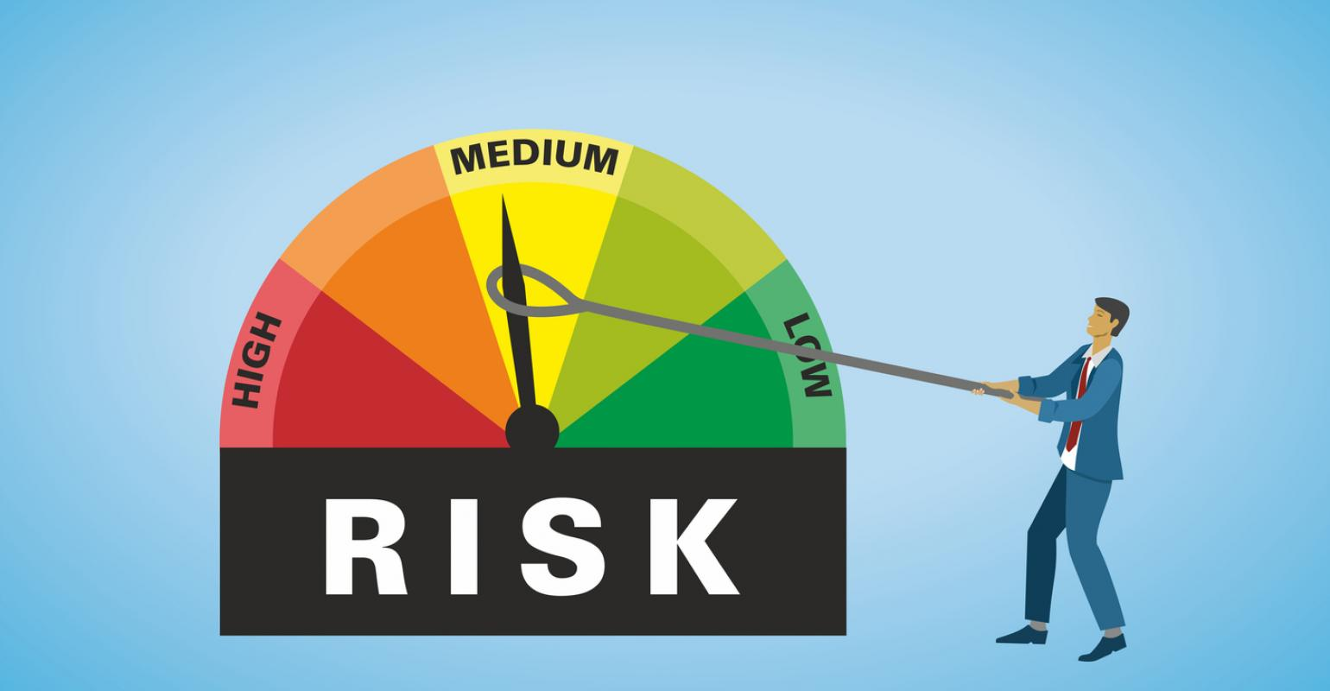
MACRO RISKS – HIGH LEVEL
Operational
Credit
Market
Liquidity
Reputation
Systematic
Moral
Business
Notes:
What are Macro Risks?
Macro risks tend to be high level problems that can seriously harm or hinder an organization. These kind of risks do not boil down to one specific problem, but rather blanket a sector.
Operational risks may be day-to-day business activities of the company, a breakdown of internal problems composed of micro risks.
Credit risk may be the possibility of loss resulting from borrowers' failure to repay a loan or meet contractual obligations.
Liquidity risk is the possibility of a bank inability to meet its obligations, as a payout or withdrawal.
Market Risk is the possibility of a financial market downturn, affecting finance-tied obligations.
Business risk is the broad risk that an exposure to a malignant factor will negatively reflect on the business, lowering its profits.
Reputation risk has to deal with tarnished reputation, and loss of business due to a perceived image.
Moral risk is a hazard that a party has not entered a contract in good faith, or provided misleading information.
Systematic Risk is tied to market segment and its volatility, its also known as undiversifiable risk.
Chen, J. (2022, March 14). What Is Systematic Risk? Investopedia. Retrieved May 8, 2022, from https://www.investopedia.com/terms/s/systematicrisk.asp#:%7E:text=our%20editorial%20policies-,What%20Is%20Systematic%20Risk%3F,a%20particular%20stock%20or%20industry.
EICHLER, R. (2022, March 15). What Is Credit Risk? Investopedia. Retrieved May 8, 2022, from https://www.investopedia.com/terms/c/creditrisk.asp

Slide 5

MICRO RISKS – SPECIFC RISKS
Operational Risk Category from Basel II
Internal Fraud
External Fraud
Employment Practices
Clients and Products
Business Practices
Damage to Assets
Business Disruption
System Failures
Notes:
Unlike macro risk, micro risks are specific risks based solely on company and its situation. They may be smaller in scope than Macro risks but pose the very real threat to profit margins or business continuity.
Some examples are Internal fraud – an employee defrauding assets from his company,
External Fraud – fraud committed by entities outside the organization, like vendors, customers or competitors.
Employment practices – problematic hiring decisions, promotion, discipline or termination, discrimination can all lead to potential costly lawsuits.
Or System Failures – it can be an internet or power blackout, or internal system failure preventing proper execution of services.
Although specific, these problems can be numerous, any organization can benefit from proper risk management, when up against potential loss in profits!
Hartwig Moss Insurance Agency. (2022). Employment Practices, Risk and Management. Hartwig Moss Insurance Agency Blog. Retrieved May 8, 2022, from https://www.hmia.com/blog/employment-practices-risk-and-management

Slide 6
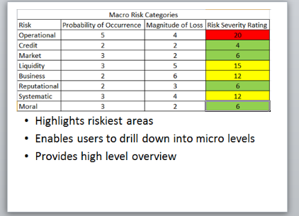
How to Track MACRO Risks?
RISK SEVERITY-
“The extent of the damage to the institution, its people, and its goals and objectives resulting from a risk event occurring.”
Stanford University. (2022). Definition of Risk Severity. Office of the Chief Risk Officer. Retrieved May 8, 2022
Notes:
Now that we have a general understanding of what risks are and how they can be categorized, we can dive deeper into understanding how to track and manage them.
Starting off with Macro risks, we can quantify the chances of it appearing, and magnitude of loss. With those two numbers we simply multiply them and are presented with the Risk Severity Rating. A visual aid of color can help us understand Risk severity rating of the risk listed. Green for lowest severity, yellow for medium and red for high.
This kind of set up lets us understand, the potential dangers, and their components at a micro level with a quick glance.

Slide 7
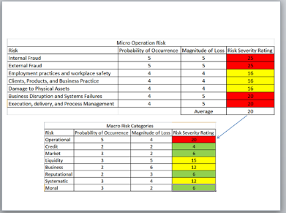
Drilling down to MICRO risks
Relationship between MACRO and MICRO risks is that of a parent and a child.
Notes:
Previously we have taken a look at a high level overview of the possible macro risks, in this slide we can break down each of those Macro risks into Micro risks for further evaluation.
In this example our Macro Operational risk is red, when we drill down to what makes this risk up we come up with a few specific risks. Internal and External fraud, Employment practices and workplace safety, Clients, product and business practice and so on.
By drilling down, we can create actionable segments to focus on. Creating actionable items to address current, or potential problems.
The importance of tracking, and breaking down risks is paramount to an analogy between jumping 3 floors in one go or simply taking the stairs.

Slide 8
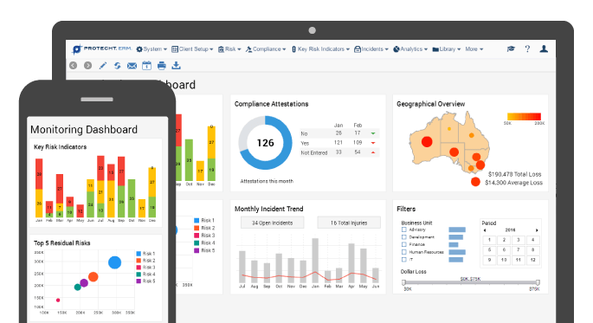
Data Analytics and Risk Management
-Identification
-Assessment and Prioritization
-Response and Mitigation
-Monitoring
-Reporting
Notes:
Data analytics is simply making sense of data, although individual or subjective understanding is still important, the understanding of unbiased outcomes and trends associated with them is crucial.
Data analytics is the deeper understanding of patterns in data that may be too large or too convoluted for an average eye to ascertain.
By injecting proper procedures, scientific thinking and structured paradigms we are able to create deeper understandings of how opportunities or problems arise.
How can we integrate that kind of systematic analytics to risk management?
By creating rules and guidelines for Risk:
-Identification
-Assessment and Prioritizations
-Response and mitigation
-Monitoring and
-Reporting
Ruia, V. (2021, February 22). Role of data analytics in risk management. EY. Retrieved May 8, 2022, from https://www.ey.com/en_in/risk/role-of-data-analytics-in-risk-management

Slide 9
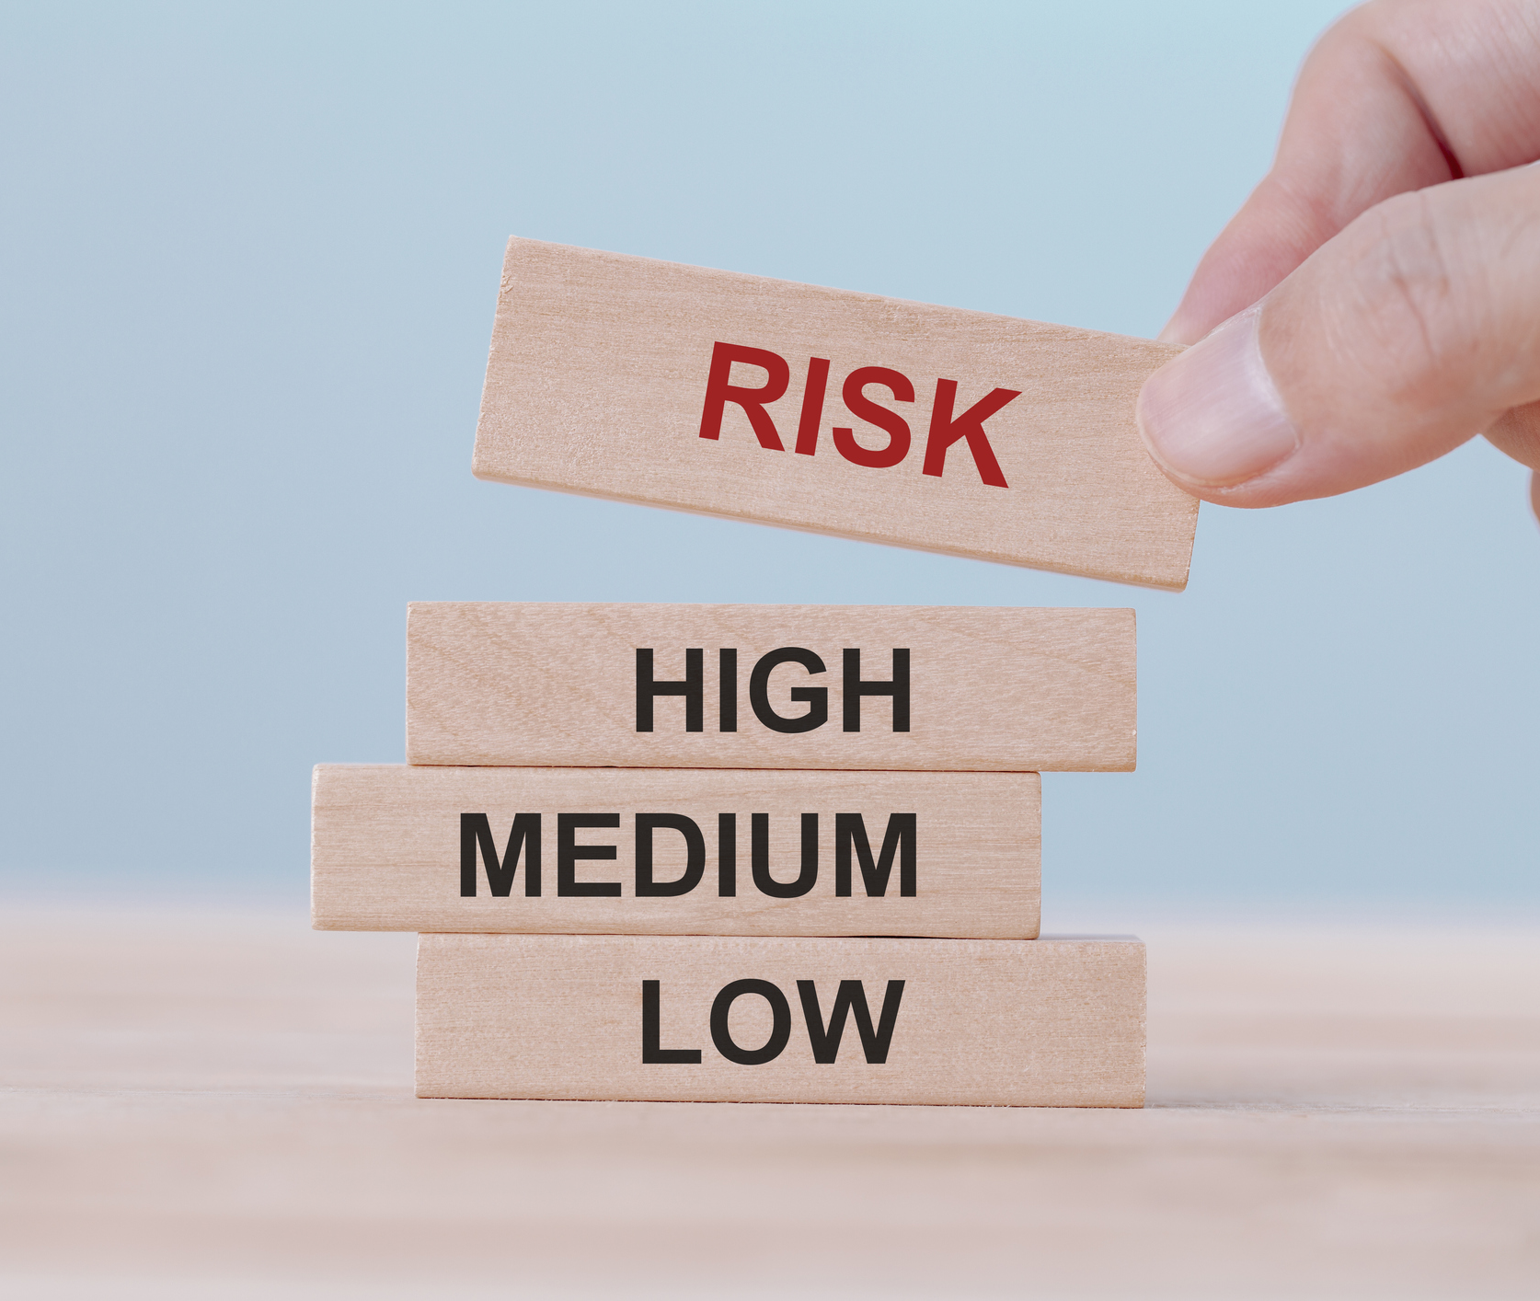
RISK IDENTIFICATION
Usage of Big Data
Identification of latent threats
Sophisticated Tools
Notes:
Due to how quickly the world has change due to analytics practices, the diversity of tools necessary to clean, sort and understand the data is enormous.
First step to prevent or minimizing a risk is to identify if it even is a risk. Thanks to software, and liberal amount of data, it has become much easier to understand possible factors, and quantify if certain practices affect the bottom line.
First step is to be aware, and notice your target!

Slide 10
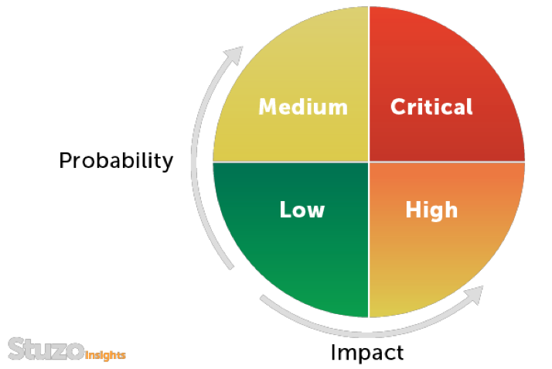
Risk Assessment and Prioritization
Understanding Indicators
Quantifying Impact
Profiling based on Metrics
McLean, A. (2011, March 17). Risk Prioritization [Illustration]. Stuzo.
Notes:
We all tackle this task in our everyday life. We prioritize tasks that are important after a brief assessment. No one would try to vacuum the dirty carpet when a tornado approaches.
Understanding the landscape of risk and making functional and informed decisions is a must for an organization to stay healthy.
Profiling risks based on magnitude, and probability is a good way to understand possible impact a risk may have but lets go a step further. Rather than doing this manually, and profiling risks subjectively, we can let an analytical framework asses them in real time, with predicted impact severity.

Slide 11

Risk Response and Mitigation
Effective and Appropriate response
Alternative Choices
Consequences and Impacts
Notes:
When we have id’d, assessed, prioritized the risk, the next step is to Respond to it. Having a choice, and potential metrics on operations availability or financial impact is necessary to navigate the business through potential hazards.
A mitigation, might act as a timely and cost effective course correction on our business vessel.
Having the ability to preview potential “what if” scenarios is almost like a cheat code!
Data analytics can be leveraged to track effectiveness of certain implementations to make for better predictions in the future.

Slide 12
Risk Monitoring
Identifying indicators
Lead Indicators and Lag Indicators
Data source and parameters
Ability of automated reports, reminders and alarms
Notes:
Important factor of Risk Monitoring is timeliness. Having the ability to monitor near real time and making adjustments can save an organization lots of financial backtracking.
Identifying lead and lag indicators, as well as proper data sources and other parameters, can help to gain timely insights into decisions or outcomes.
An ability to automate certain reports, alarms or reminders is a great asset in mitigating potential financial or operational damage.

Slide 13
Risk Reporting
Internal Compliance
External Compliance
Benefits of recycling data
Past Learnings
Notes:
Risk reporting is the final piece of this life cycle. Gaining ability to stay internally compliant to track performance metrics or externally compliant to a regulatory body and spot possible infractions is a great way to mitigate potential audit costs and negative impacts.
The benefits of recycling data are huge, making larger and more complex models can help bring more problems into light, making operations smoother.
Staying responsible as a company, learning from the past and allowing transparency are all great ways to boost rapport with potential and current consumers.

Slide 14
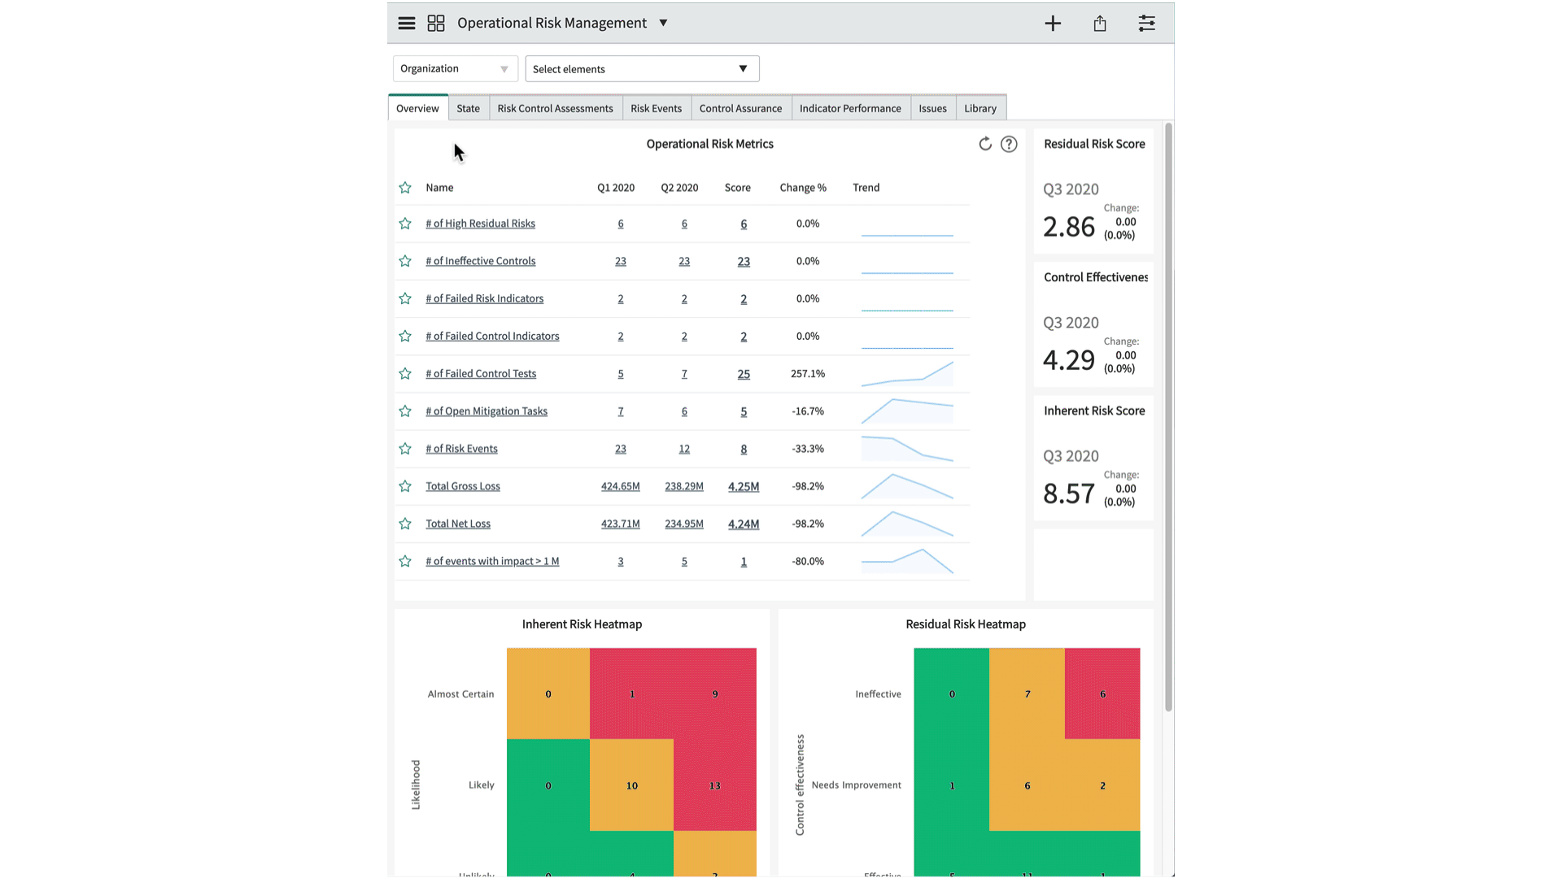
Risk management Dashboard
Produce Visualizations
Track in Real Time
Understand and break down factors
Make informed decisions
Service Now. (2022, February 3). Operational risk dashboard [GIF]. ServiceNow.
Notes:
Merging data analytics and risk management into a single piece of software where a user can track in real time potential metrics, analyze data, and create reports is like a dream come true.
Leaving the hard data in the background these softwares enable the users, a customizable approach to managing risks, and their potential outcomes.
This is the future of Risk management.
Service Now. (2022, February 3). Operational risk dashboard [GIF]. ServiceNow. https://docs.servicenow.com/en-US/bundle/sandiego-governance-risk-compliance/page/use/dashboards/application-content-packs/operational-risk-dashboard.html

Slide 15

Questions?
Contact information: Presenter: Marek Krawczyk
Marek.krawczyk@snhu.com
Phone: (413)-219-2831
Thank you!
Notes:
Thank you for giving me this opportunity to brief on the potential upsides of risk management integrated data analytics. I hope you found it interesting and educational.
In an earnest effort to return your kindness, I will take any questions you might have. If you wish to go back to any slide or explain any subject in more detail I would be more than happy to do so.

